Slide 1

Student Performance & Productivity Analysis using Python.

Slide 2
About We
We are passionate learners with a strong interest in data analysis and problem-solving.
In this project, we worked together to analyze student productivity and exam performance using Python.
We divided responsibilities equally and collaborated to generate insights and visual reports.
Summary
This project analyzes various factors affecting student productivity and exam performance. Using Python and data analysis libraries, we examined how study hours, sleep, social media usage, burnout levels, and other lifestyle factors influence exam scores. The analysis helped identify key patterns and relationships that impact academic success.

Slide 3

Table of Content
Libraries
Dataset Load
Basic Analysis
Describe Data
Show Unique Data
Charts

Slide 4
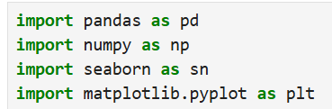
Libraries
1
In this project, Pandas was used to load the dataset, clean and organize the data, calculate averages and correlations, and prepare the data for visualization and further analysis. It played a key role in handling the student performance dataset efficiently.

Slide 5
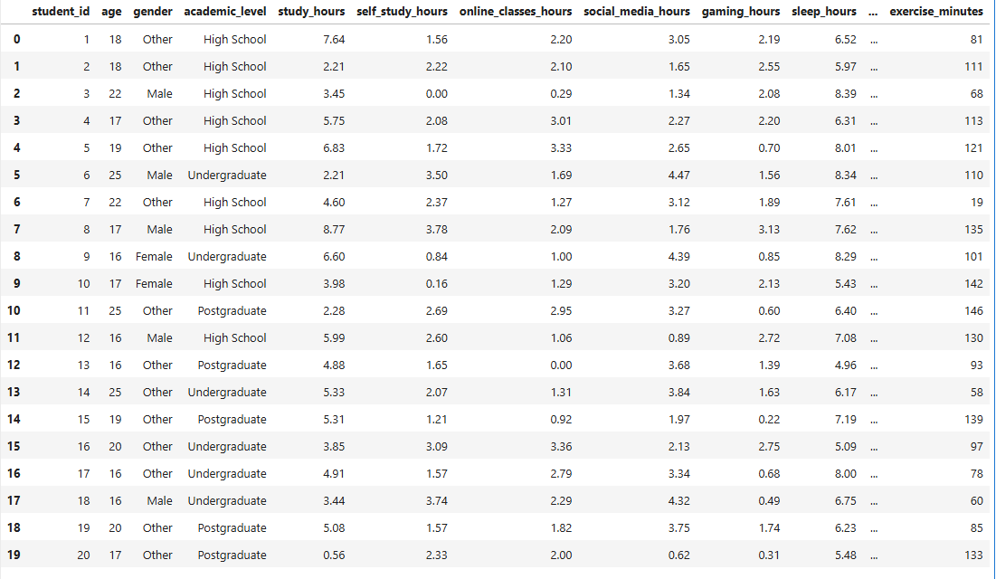
Dataset Load
2

Slide 6

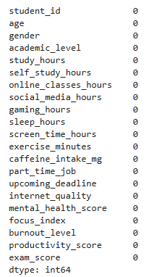
Basic Analysis
3

Slide 7

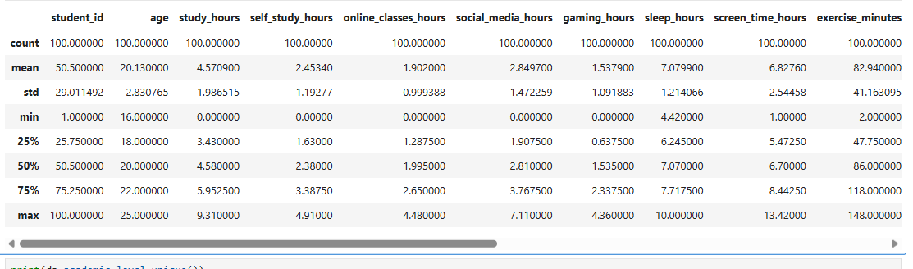
Describe Data
4

Slide 8


Show Unique Data
5

Slide 9

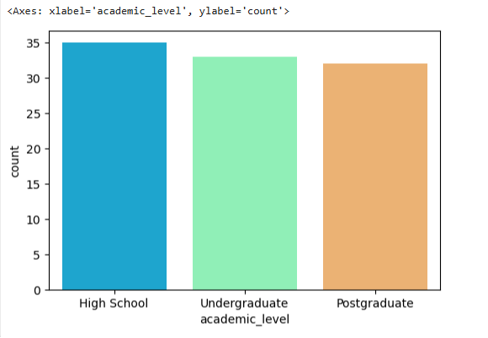
Charts
6

Slide 10
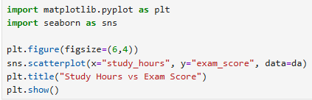
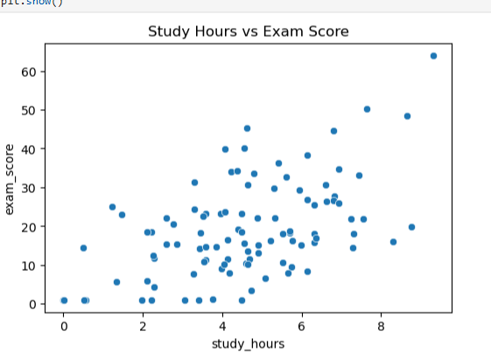
Charts
7

Slide 11

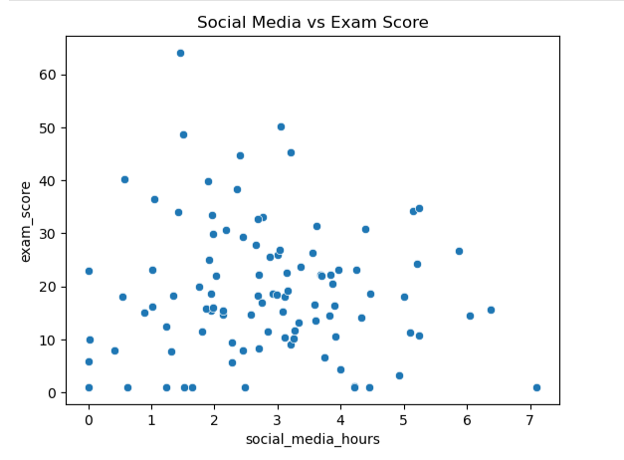
Charts
8

Slide 12
Thank You
Divy_Shah
Anis_Khan

